Slide 1



OWASP en .NET: Intro a OWASP y SQL Injection

Slide 2
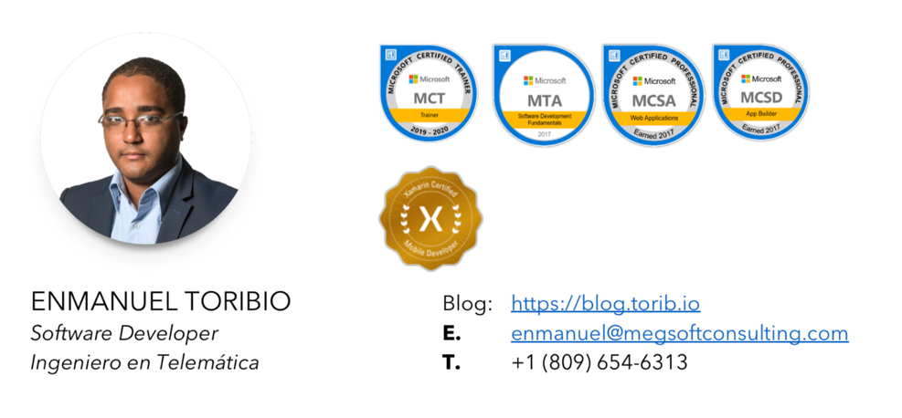

Slide 3
Agenda
Why is web security important?
¿Qué es OWASP?
Top 10 riesgos de seguridad más comunes
SQL Injection
¿Qué es?
¿Cómo se evita?
Caso real
info@megsoftconsulting.com

Slide 4
Why is web security important?
info@megsoftconsulting.com

Slide 5
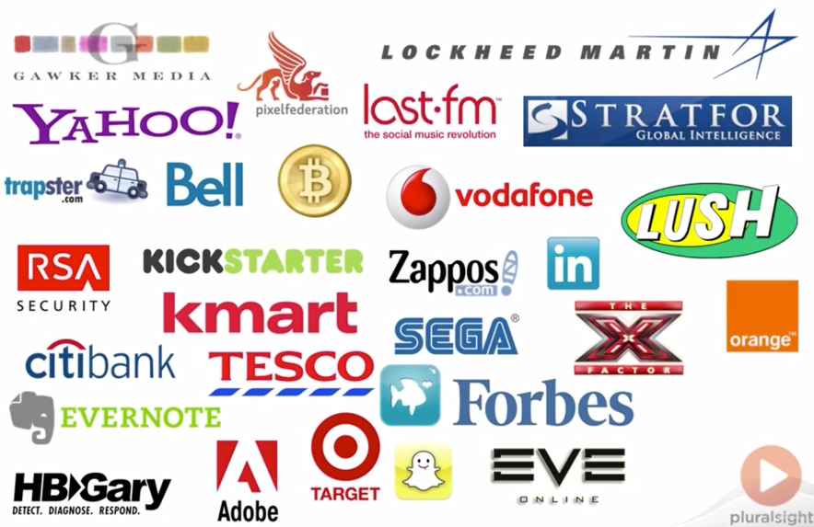

Slide 6
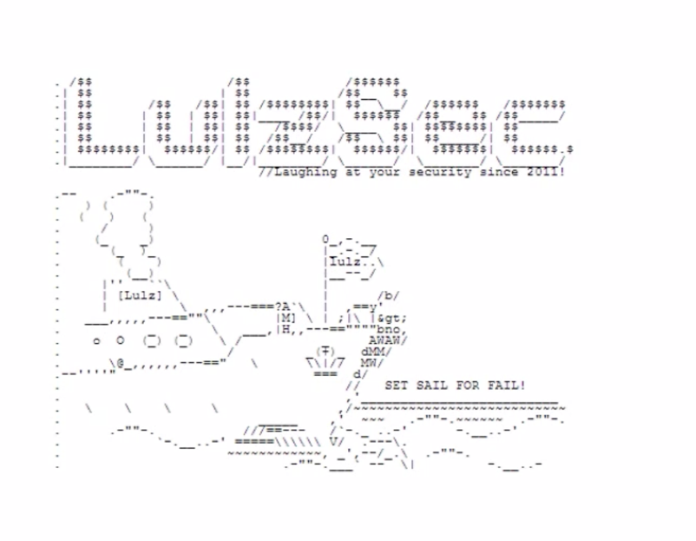

Slide 7
¿Qué es OWASP?
Notes:
Open Web Application Security Project
https://www.owasp.org/
Free
Agnostic
Security Community
Certificación
https://app.pluralsight.com/paths/certificate/comptia-security-sy0-501

Slide 8
Top 10 OWASP
Injection
Weak authentication and session management
XSS
Insecure Direct Object References
Security Misconfiguration
Sensitive Data Exposure
Missing Function Level Access Control
Cross Site Request Forgery
Using Components with Known Vulnerabilities
Unvalidated Redirects and Forwards

Slide 9
SQL Injection

Slide 10
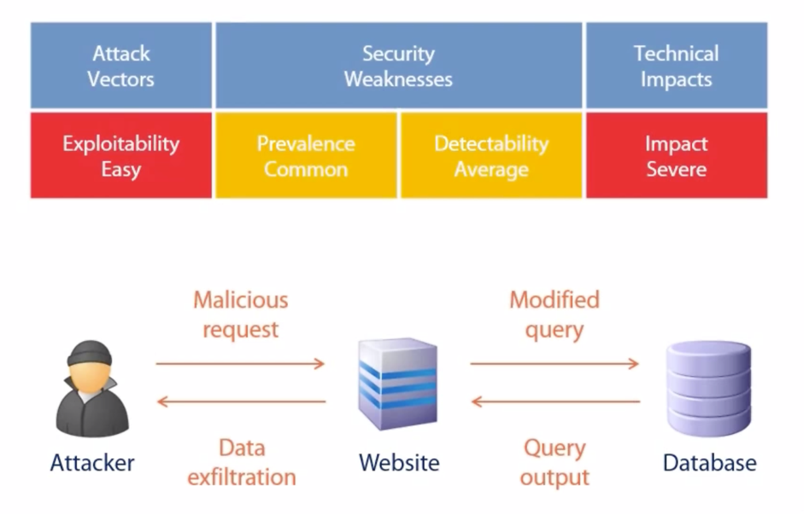

Slide 11
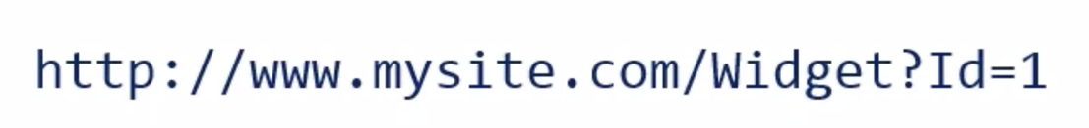

Slide 12
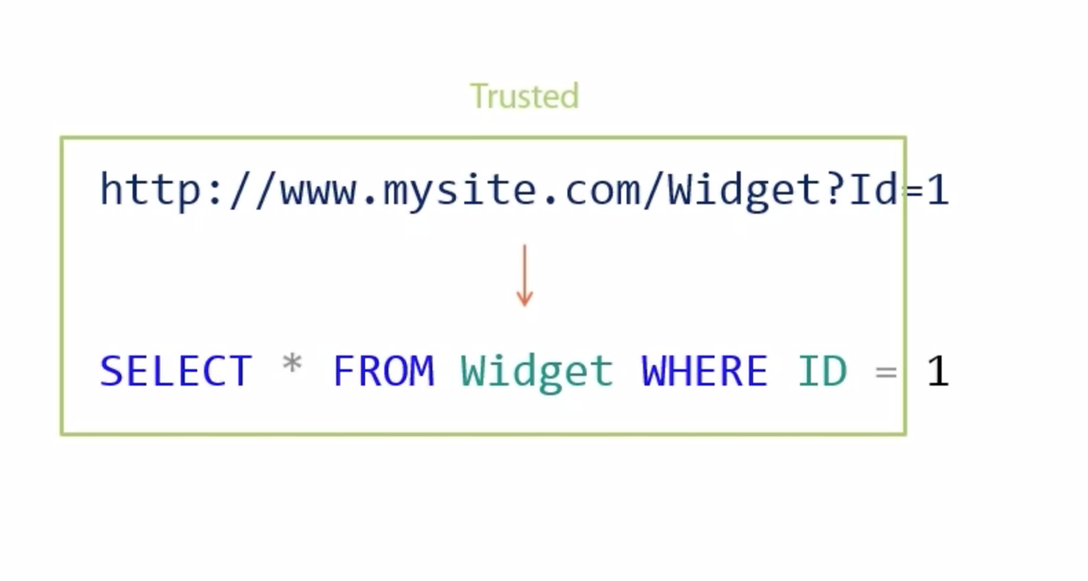

Slide 13
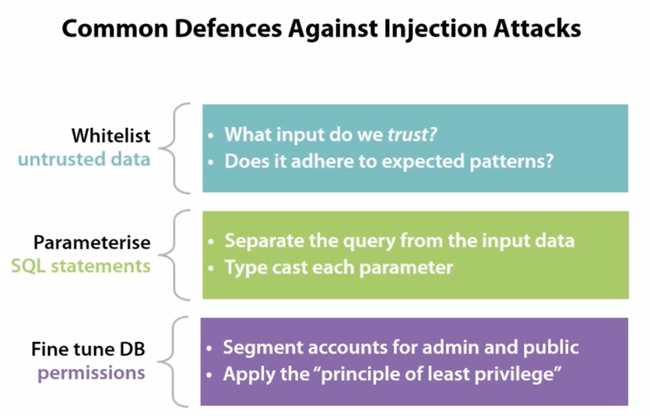

Slide 14


Slide 15
What’s next?
Encriptación

